Slide 1
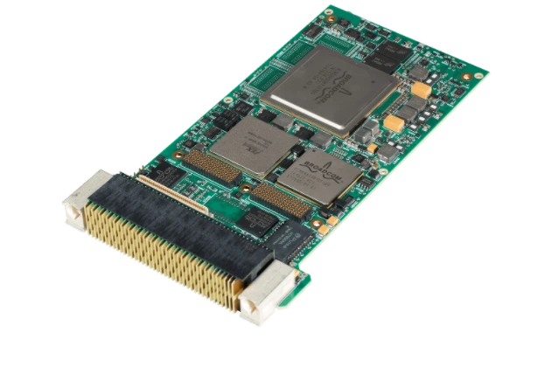
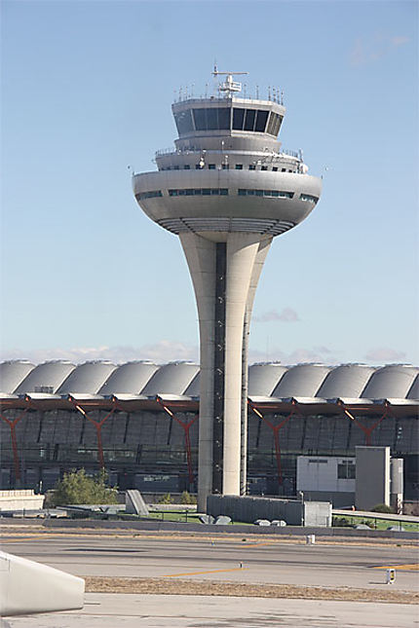
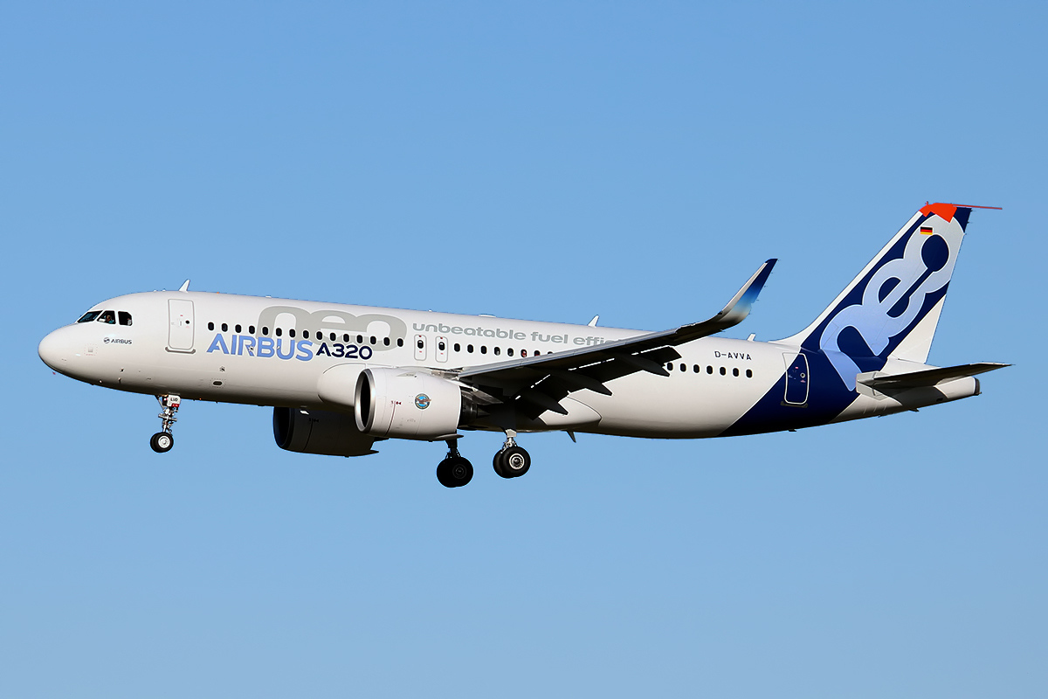
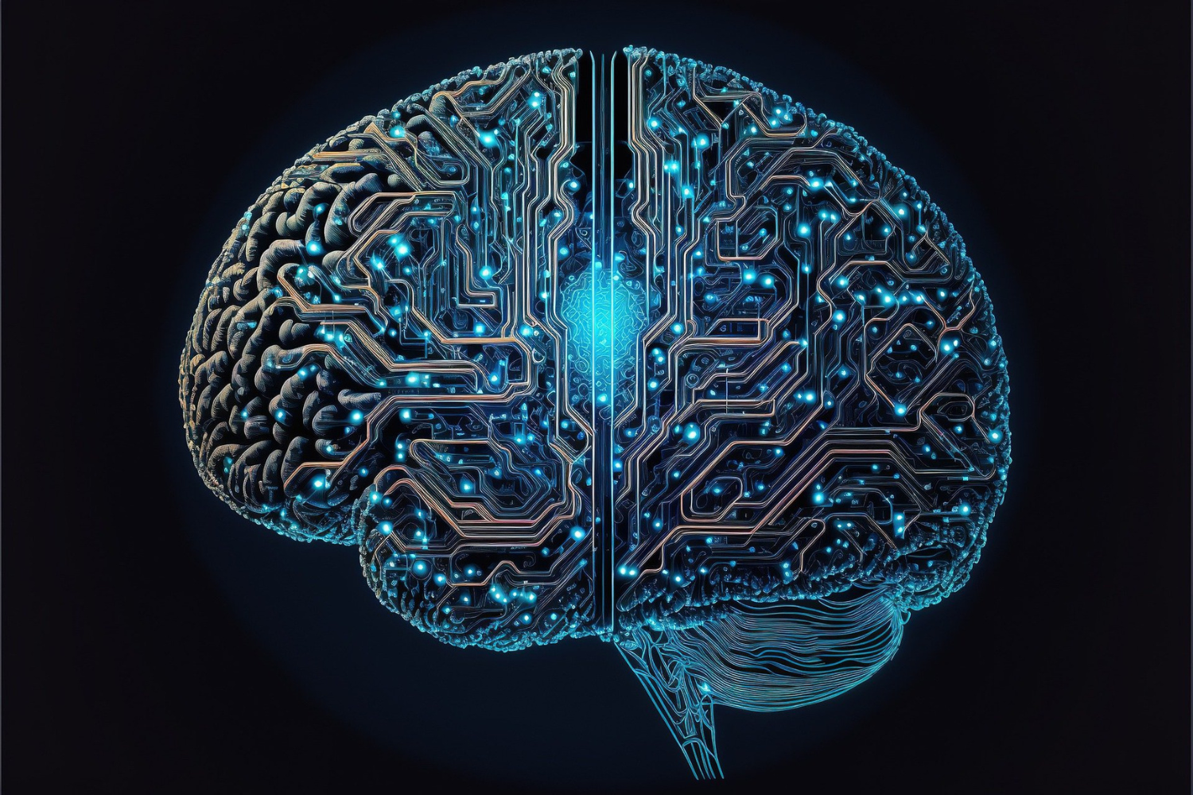
Quantum-Ready Sky Architecture Overview
Raw Data
PQC Engine (CRYSTALS-Kyber/Dilithium)
Quantum-Resistant Encrypted Data
Blocked / Alert sent
🛡️
Sensors, Avionics & IFE Systems.
AI Supervision Agent (Unsupervised Learning)
Cyber Attack / Spoofing
Hybride Module
Secure SATCOM / IP-Datalink.
🛡️ Cryptographic Agility
⚡ Real-Time Performance
🧠 Proactive Detection

